Slide 1



Competências nucleares para o século XXI
Criatividade, espírito crítico e empreendedorismo
Prof. Doutor Carlos Sousa Reis
csreis@uc.pt
CONFERÊNCIA aberta * 10.3.2023 * Curso de doutoramento em ciências da educação

Slide 2
ÍNDICE
1 de 28
slides
Competências cruciais para o século 21
Empreendedorismo e natureza humana...
A importância da criatividade e do pensamento crítico
Abordando a criatividade
Abordando o pensamento crítico
Dinâmicas de complementaridade entre criatividade e pensamento crítico

Slide 3
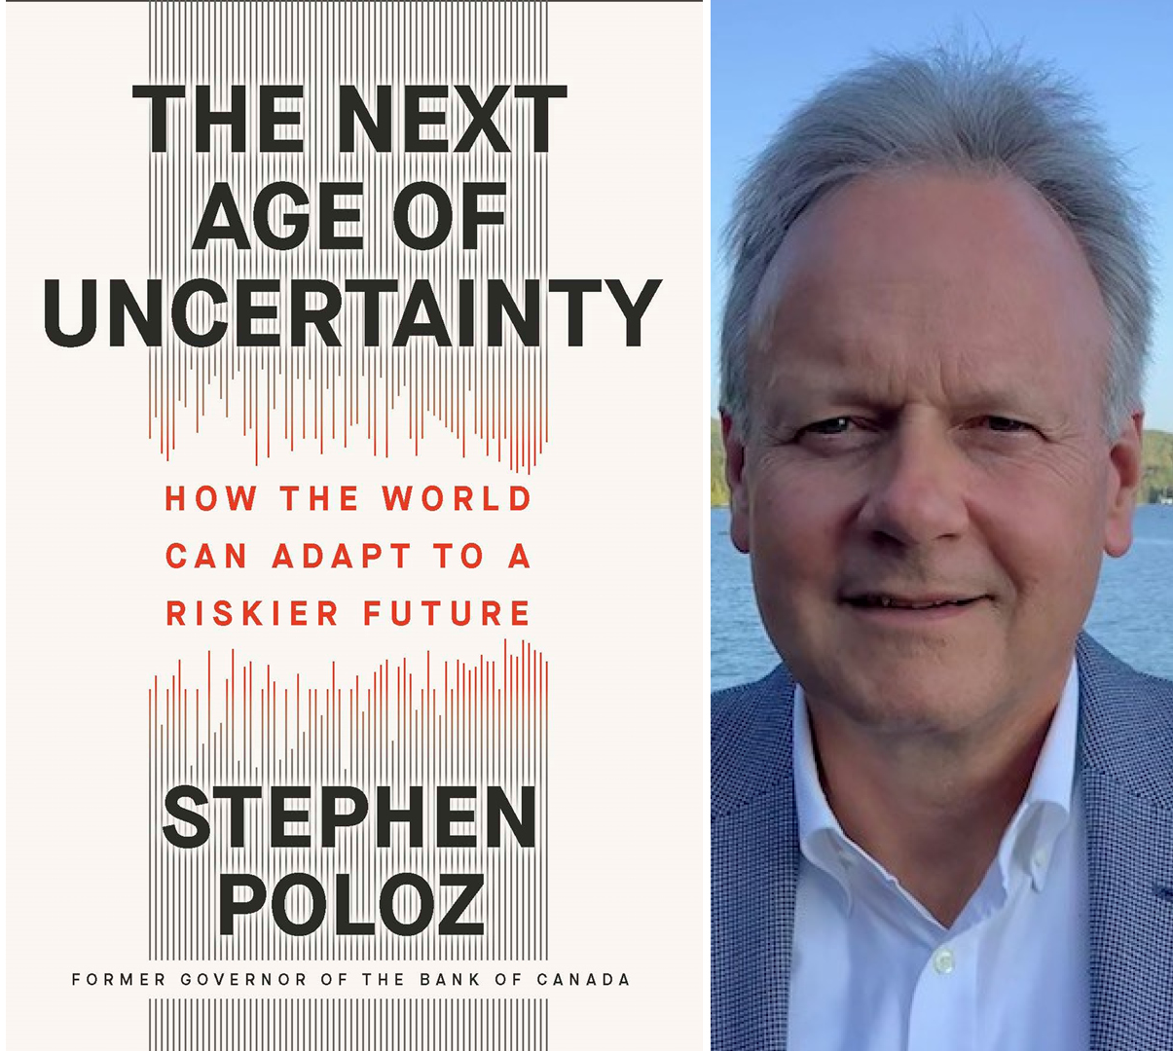
1. Competências cruciais do século 21
the contextual drive
Sociedade da Aprendizagem
(Hutchins, 1968)
Sociedade do Conhecimento
(Bell, 1973)
Conhecimento recurso crucial
economias da competividade inovação
(Drucker, 1993a, 1993b, 1994)
redes funcionamento expansivo
(Castells, 1996, 1997, 1998, 2004)
transformação e inovação contínuas
(Reich, 2001)
aumento da incerteza, complexidade, disseminação do alto-risco
(Blackmore, 2000; Beck, 1992)
Época da Incerteza
(Elliot & Atkinson, 1999)

Slide 4
1.1. o pano de fundo: desenvolvimento indefinido ambiente ameaçado mundo num apressado (Schleicher, 2018) a mudança é a única constante (Harari, 2018)
populações em crescimento > universalidade da educação? hipermobilidade - modernidade líquida > falta de sentido
esgotamento de recursos > necessidades gerações futuras mercantilização
mudanças climáticas > sustentabilidade > gerações futuras
tecnologias&globalização: desafios/oportunidades > aceleração produtividade > incremento conectividade volatilidade+complexidade+incerteza mundial
aceleração, fragmentação: vazio narrativas (Han, 2016)> desorientação, falta de ancoragem

Slide 5
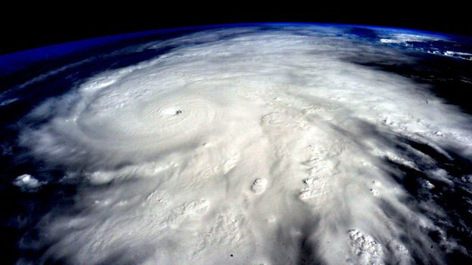
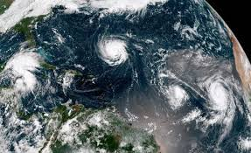
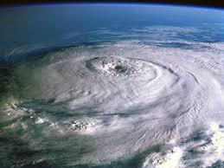
tempestade perfeita
(Harari, 2018; Han, 2016)
revolução inteligência artificial
evolução bioengenharia
catástrofe climática recursos
vazio narrativas

Slide 6
2. Empreendedorismo e natureza humana…
seres de desafios&projetos
nos projetamos
transcender-se
iniciativa & criatividade
Ideologia inculpaçãp > desempregados
resposabilidade criar próprio emprego
imaginário vontade: todos podem/devem triunfar
luta lugar sol
sociedades competitivas inovadoras sustentáveis inclisivas e justas
recursos infinitos???
problemas ambientais > equidade de crescimento
empreendedorismo equilibrado respeito diferença e diversidade > sustentabilidade
riscos
Marco Polo (1254-1324) rota venda bens de capitalista > correndo riscos:
“o empreendedor aventureiro" (Dornelas, 2008, 14)
Jean Baptiste Say (1767-1832),
“empreendedor" > "planificador" (Brewer, 1992)
abrir vias enriquecimento pessoal/sociedades
capitalismo neoliberal globalizado
mercantilização
panaceia
educação saúde justiça
mercadorias ? direitos !
precarização trabalho

Slide 7
cosmovisão ecológica
ecoliteracia
pensamento
sistémico
pensar longo-prazo
Inteligência emocional
Inovação criativa
inteligência espiritual
propósito
contributo pessoal
fluxos cíclicos
dialogia
interconexão
inscrição natural
mindefulness
reflexão crítica
conscientização
educação ecojusta
(Martusewicz & Johnson, 2016; Martusewicz, et al. 2011)
(Rimanoczy, 2021)

Slide 8

“empreendedodrismo uma mentalidade.”
(Commission of the European Communities, 2003, 4).
motivação e capacidade indivíduo/organização
identificar oportunidade e perseguir
produção valor
criatividade ou inovação
competir
mudar
criar um novo mercado
transformar ideia em sucesso
criatividade ou inovação + boa gestão
otimizar desenvolvimento
todas as fases do ciclo de vida.
vai além da gestão diária
diz respeito a visão e estratégia

Slide 9
EntreComp Framework
entrepreneurship as a competence knowledge, skills and attitudes
(Bacigalupo et al., 2016)
1. transversal competence
all spheres of life
cultural, social or commercial
private, public and third sectors
2. bridge the worlds of education and work
transversal key competence
individuals, groups and even organisations
3. act upon opportunities and ideas
transform into value
financial, cultural, or social

Slide 10
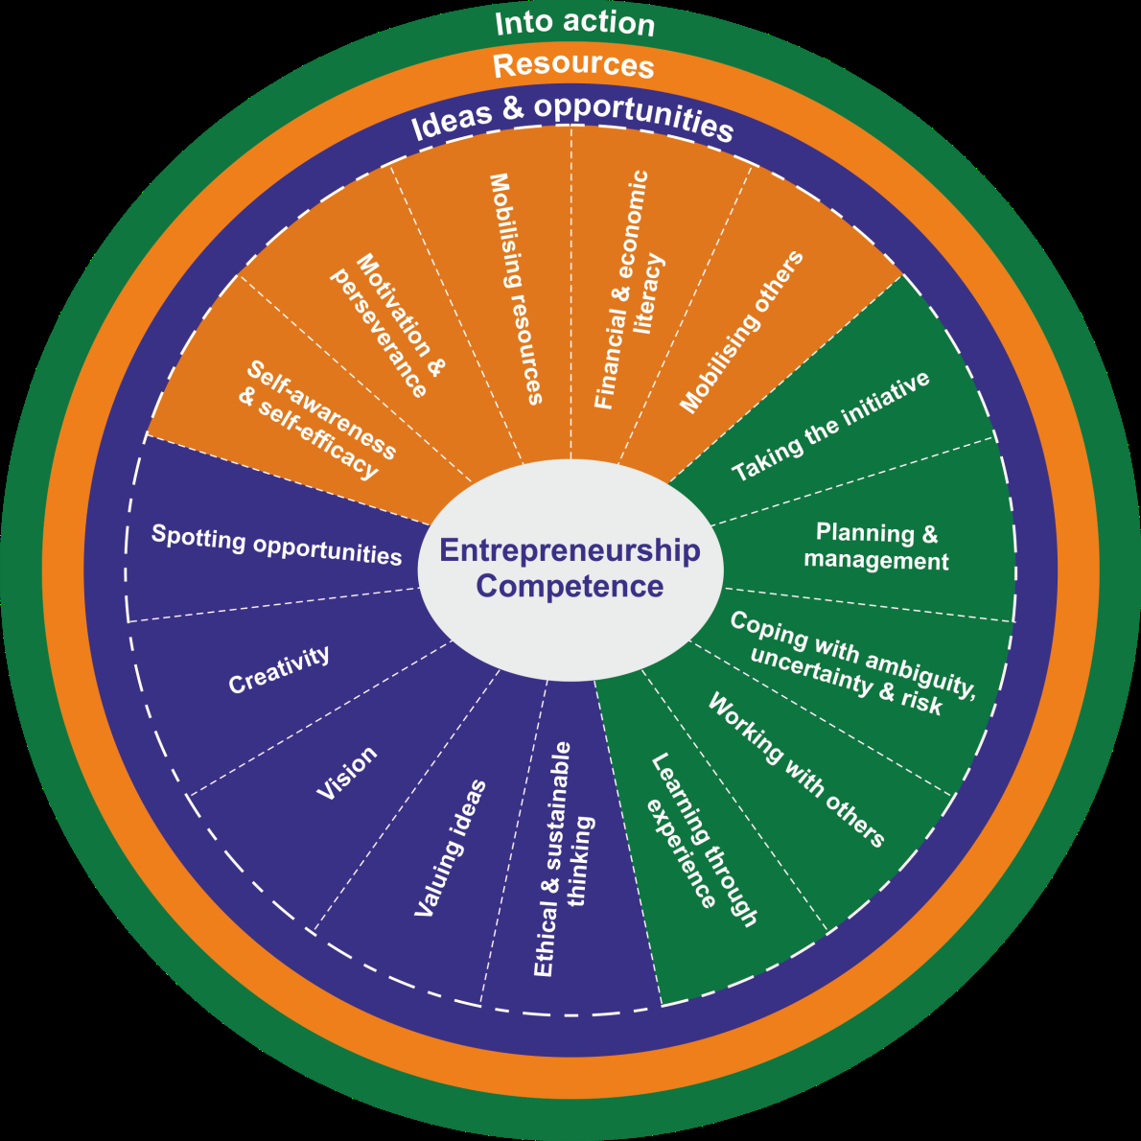
Areas and competences of the EntreComp conceptual model (Bacigalupo et al., 2016, 11).

Slide 11

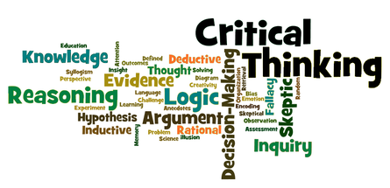
3. The importance of Creativity and Critical Thinking
creative person
sound basis of knowledge & competencies
(Christodoulou, 2014)
relationship between entrepreneurship
Creativity (C)
(Kizkapan & Nacaroglu, 2021; Lubada, Kusumojanto & Indrawati, 2021; Jiang, Wang, Wang, & Li, 2020)
Critical Thinking (CT)
(Budi & Farcis, 2021; Papageorgiou, Yiannaki & Varnava-Marouchou, 2021; Kırbaşlar & Özsoy-Güneş, 2015; Knoff & Timmons, 2015; Yaldiz, & Bailey, 2019; Kalar, 2020)
highly valued
industry, business, education, research, science, and arts
(Suciu, 2014)

Slide 12
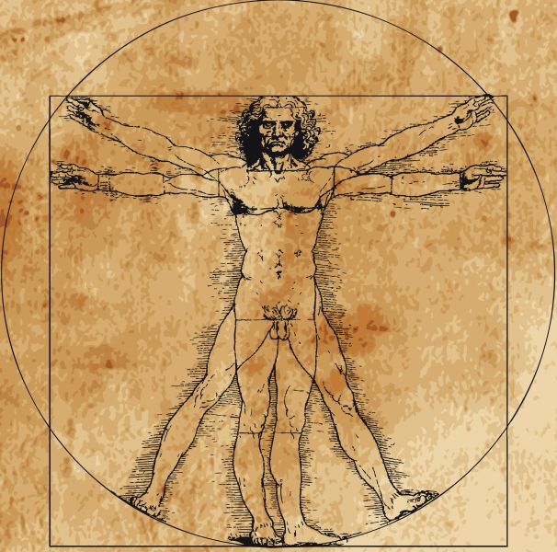

Modernity
promoted rationality
left brain hemisphere
Post-modernity
complex ambiance, constant of change (Harari, 2018)
right hemisphere as the great promise and challenge
systematically reinventing ourselves (Harari, 2018)
UNESCO (2016) studies
creativity - critical thinking
problem-solving
decision making
crucial competencies
one side intensive activation implies synergic activation (Hasenkamp & Namgyal, 2017; Haynes & Rees, 2006; Jung-Beeman et al. 2004)

Slide 13
“Reflective practice is needed to take a critical stance when deciding, choosing and acting, while cognitive skills, such as analytical or critical thinking are needed to foresee what may be needed in the future or how actions taken today might have consequences for the future”
(Schleicher, 2018, p. 24)
C and CT skills
core to success 21st
shift central to education policy
close ahead demands.
(Schleicher, 2018).
C and CT
combined competencies 21st-century mindset
research
broadband of realms
(Sarwanto, Fajari & Chumdari, 2021)

Slide 14
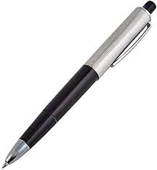

4. Approaching creativity
Creativity
(multifaceted phenomenon, defining and handling it becomes a very complex task)
-“Creativity is the interplay between ability and process by which an individual or group produces an outcome or product that is both novel and useful as defined within some social context”
(Plucker & Zabelina, 2009, p. 6)
-Compared to a valuable asset for solving personal, organisational and social problems and achieving sustainable development
(Barbot, Besançon, & Lubart, 2015; Lubart, Zenasni, & Barbot, 2013, cit. in Said-Metwaly, Van den Noortgate & Kyndt, 2017)
producing a novelty
surprising or original
intertwined with a “purpose” or have some utility
“novelty does not guarantee that something will be effective”
(Amabile, 1989, 1996; Oldham & Cummings, 1996; Zhou & George, 2001, cit. in Mishra & Henriksen, 2013, p. 11).
a solution that is Novel, Effective, and with aesthetic wholeness
(Mishra & Henriksen, 2013, p. 13).

Slide 15
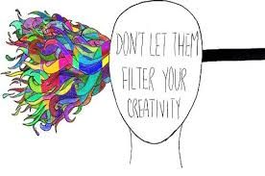
analysis of 42 definitions on the concept of C, Kampylis and Valtanen (2010) found that most of the definitions analysed were focused on four components:
Creativity is a key ability of individual(s);
2. Creativity presumes an intentional activity (process);
3. The creative process occurs in a specific context (environment);
4. The creative process entails the generation of product(s) (tangible or intangible). Creative product(s) must be novel (original, unconventional) and appropriate (valuable, useful) to some extent, at least for the creative individual(s) (p. 198).

Slide 16
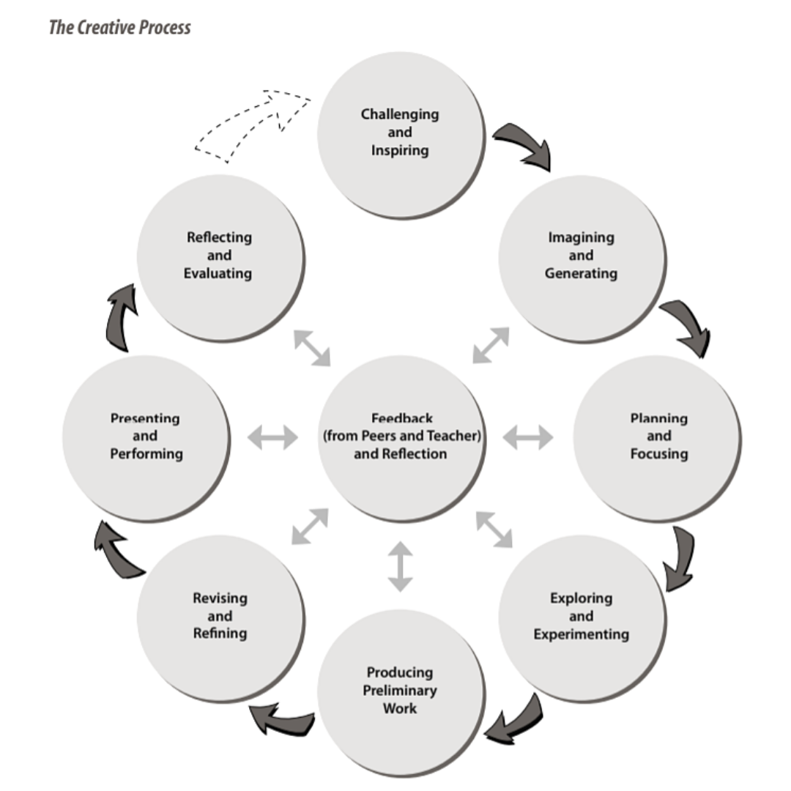
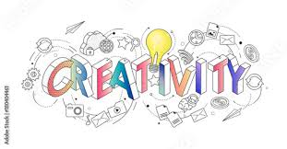
creativity
Models
(Colin, 2017)
Stage-based Models: a problem-solving process that can comprise four phases:
1. Preparation;
2. incubation;
3. illumination
4. verification.
Convergent and Divergent Thinking:
-convergent thinking relates to the type of thinking that links one solution to a problem, while
-divergent thinking refers to many possible ideas and solutions > C
Taxonomies
Blind Variation, Selective Retention (BVSR):
production of solutions to a problem and evaluation each solution as useful/appropriate
The Systems Model (SM):
resulting “from system composed of three elements: a culture that contains symbolic rules, a person who brings novelty into the symbolic domain, and a field of experts who recognize and validate the innovation” (Csikszentmihalyi, 1996, cit. in Colin, 2017, p. 27)

Slide 17

creativity
Models
(Colin, 2017)
Taxonomies
4 Cs: Mini-c, Little-c, Pro-C and Big-C
4 Ps: Person, Process, Press, Product (Persuasion, Proclivity)
person refers to how each person develops C as a person having a certain characteristic
process is mostly related to the cognitive mechanisms that regulate the production of novelty
press refers to the environment where creative ideas occur
product concerns the result, including the communication of the ideas, whether unique, new/novel and/or useful
“Mini-c” relates to personal and developmental aspects of creativity, trying to catch what “Little-C” may miss, serving, for instance, for recognising and distinguishing between the genesis of creative expression
"Little-c" concerns solving everyday problems and is compared to "everyday creativity"
"Pro-C" refers to the high achievement of C, which is related to creative professionals, that use, replicate, improve and reconstruct pre-existing products and begin the process of transferring them to a new starting point, remaking knowledge structures.
"Big-C" pertains to creativity that is linked to famous works of great relevance, being considered the kind of C which is present in the ideas that have transformed societies and the world

Slide 18
Approaches to creativity measurement
(adapted from Said-Metwaly, Kyndt, and Van den Noortgate, 2017)
Approach | Focus | Conception of Creativity | Instruments | Advantages | Weaknesses
Process | Creative processes or skills associated with creativity | Domain- general | RAT (Mednick, 1962); WKCT (Wallach & Kogan, 1965); TTCT (Torrance, 1966, 2008); SOI (Guildford, 1967); CAP (Williams, 1980); TTC-DP (Urban, 2005); EPoC (Lubart et al., 2012) | Widespread utility High reliability Standardized criteria for interpreting scores | Limited scope of measurement conflicting evidence for validity Bias due to scoring and sample size
Person | Personality traits or creative achievements | Domain- general or domain- specific | HDYT (Davis & Subkoviak, 1975); CPS (Gough, 1979); CBI (Hocevar, 1979c); GIFT (Davis & Rimm, 1980); HCAY (Raudsepp, 1981); WKOPAY and SAM (Khatena & Torrance, 1990); NEO Personality Inventory and NEO Five-Factor Inventory (Costa & McCrae, 1992); RIBS (Runco et al., 2001); CAQ (Carson et al., 2005); BICB (Batey, 2007) | Ease of use High reliability Standardized criteria for interpreting scores | Limited scope of measurement Low validity of self-reports Bias due to self-reporting Neglect of differences in creative personality across domains Low sensitivity to training Skewed scores
Product | Creative products | Domain- specific | CAT (Amabile, 1982); SPAF (Reis & Renzulli, 1991); CPSS (Besemer & O'Quin, 1999) | Similar to evaluating creativity in real-life High reliability High validity | Limited scope of measurement Difficulty in selecting judges Expensive and time-consuming Lack of standardized criteria
Press | Work environment or climate | Domain- general | SSI (Siegel & Kaemmerer, 1978); CUCEI (Fraser et al., 1986); WES (Moos, 1986); WEI (Amabile & Gryskiewicz, 1989); KEYS (Amabile et al., 1996); TCI (Anderson & West, 1998); SOQ (Isaksen et al., 1999); CAQ (Carson et al., 2005) | Explore whether a work environment is supportive or inhibitive of creativity Evaluate the environmental improvement attempts and corrective actions | Limited scope of measurement Lack of research-based evidence Debate about “climate” meaning and measurement level Individual differences in conception of climate

Slide 19
5. Approaching critical thinking
Critical thinking
problematic concept
(Niu, Behar-Horenstein & Garvan 2014; Puig et al., 2019)
Critical thinking conscious examination was rare before the 90s, and teachers and scholars seem to take the concept based on faith and as if it was drawn from given common comprehension, as a self-evident foundation of Western thought, that they have learned intuitively
(Moore, 2013).
reality seems to refer to a human atavism, more ingrained and common than one might think. The tendency of human thought, left to itself, to be become prone to accept established belief without questioning, assume prejudices, drop down to hasty generalisation, common fallacies, and self-deception (rationalisation and wishful thinking), as well as rigidity and narrowness of approach to subjects, situations, ideas, reasoning, beliefs, attitudes and behaviours
(Critical Thinking Community, 2022b)
Critical thinking is the intellectually disciplined process of actively and skilfully conceptualizing, applying, analyzing, synthesizing, and/or evaluating information gathered from, or generated by, observation, experience, reflection, reasoning, or communication, as a guide to belief and action. In its exemplary form, it is based on universal intellectual values that transcend subject matter divisions: clarity, accuracy, precision, consistency, relevance, sound evidence, good reasons, depth, breadth, and fairness.
(Sellars et al., 2018, p. 1)

Slide 20
about any subject, content or problem
in which the thinker improves the quality of his thinking by judiciously
“Know thyself.” "Only an examined life is worth living.“
(Socrates)
“A set of unexamined lives produces a dangerous and unjust world”
Critical thinking is the autonomous way of thinking
Analyze
Evaluate
Rebuild
critical thinking is:
self directed, self-disciplined, self-monitored, self-correcting

Slide 21
Critical thinking includes a complex combination of competencies :
Critical thinking
rationality
self-knowledge
honesty
openmindness
discipline
reflexivity

Slide 22
ALGORITHM FOR CRITICAL THINKING (Paul and Elder, 2001)
patterns
  accuracy
  clarity
  relevance
  logical
  sufficiency
  precision
  depth
  significance
  fairness
  breaddth
Elements of thought
  purposes
  questions
  viewpoints
  information
  inferences
  concepts
  implications
  assumptions
that must be applied to
intellectual traits
  humility
  autonomy
  fairmindedness
  courage
  perseverance
  empathy
  integrity
  confidence in reason
To develop

Slide 23
alternatives to rationalistic, objectivistic, fixed skills and goals, absolutization of performativity and outcomes
Papastephanou & Angeli (2007)
an aporetic element able to question raising, that could better accommodate the deconstructive significance of thematizing the taken-for-granted assumptions, instead of focusing on problem solving, leading to “prudentialized minds” - tainted by ethnocentrism and echoing an instrumentalist worldview
Dunne (2015, p. 93), has bridged it with criticality stating that it “internalizes all that is good about critical thinking: (the search for truth, cogent reasons, inquisitiveness, prudence, willingness to reconsider, care [Sorge], creativity, imagination and so on), and integrates them into how we live our lives and approach the world.”
Demir et al. (2011), who stress the importance of Mathew Lipman suggestion of three types of thinking skills for teaching thinking, namely critical, creative and caring thinking, to which the authors add “hopeful thinking”. They, then, consider the four types of thinking within two dimensions: the cognitive-affective and the convergent-divergent

Slide 24
alternatives to rationalistic, objectivistic, fixed skills and goals, absolutization of performativity and outcomes
Thompson (2004) proposes that contending reasoning cannot be reduced to formal logic without the hindrance of the contexts used to create meaning. Meaningfulness and truthfulness depend on a specific theoretical horizon that settles the “language game”
Moore (2013) has gathered research evidence of seven definition strands:
(i) as judgement: making judgements, distinctions or taking a stance – raising the question of truthfulness (and value judgements that can taint as ideology), validity (good arguments and premises leading to conclusion), or at least acceptability and even persuasiveness;
(ii) as scepticism: entailing a propensity to negative appreciation or caution in accepting judgements and ideas, including a critical view towards their own ideas, beliefs and assumptions – and those backed up by charisma or being accepted without question, the “naturalized”, common sense or “taken-for granted”;
(iii) as simple originality: meaning not just appreciate but to take the effort of producing novel ideas, coming to conclusions, “making a case”, drawing connections or “taking things outside the accepted”, i.e., lateral or divergent thinking;
(iv) as sensitive readings: that goes beyond a text’s literal meanings, engaging with its broader rhetorical framework, and unveiling the underlying motives, intentions and agendas, alongside with the historical context, which could mean to grasp the broader paradigms of writing and thinking that existed at the time of its production, which could require a non-judgemental or empathic approach;
(v) as rationality: it means seeing rationality as an universal method, i.e., a reason-based approach to thinking, looking for the best reasons, demonstrating and referring to the principles of reason and logic;
(vi) as an activist engagement with knowledge: thus going beyond acts of cognition and incorporating critical action, which could mean a socially engaged critique and taking stances of subversion, compromising with emancipation and push a particular moral; and
(vii) as self-reflexivity: in this case it means not just focus on “the form of knowledge as such, but rather turned back at the originator of these thoughts – the thinking self” (Moore, 2013, p. 518), and by self-consciousness, or self-reflectiveness focusing on how self-judgements are made, gaining the clairvoyance that our notions and judgments are always shaped by the self-perceptual and conceptual apparatus; which makes one’s accepting the impossibility of entirely objective knowledge, as well as an entirely objective critique, and rather accepting the irredeemably contingency and indeterminacy of rationality.

Slide 25
6. Creativity and Critical Thinking dynamics of complementarity
empirical research
acknowledgment of their integration, without completely excluding their independence, and in the questioning of the roles that C and CT may play in the different phases of both processes
(Wechsler et al, 2018)
devise a possibility to measure creativity with the items of originality, elaboration, fluency, flexibility, risk-taking. Moreover, they found a significant correlation between critical thinking and creativity when Digital Mind Maps were integrated into Problem-based Learning.
((Hidayati et al. 2019)
four innate elements of creativity: originality, ingenuity, resolution, and synthesis; and four external elements of creativity: replication, redefinition, reconstruction, and reinitiation. As to CT, they referred to the three elements; induction, deduction, and value judging; combined with the four methods on which they are based: results of inferences, observations, statements, and assumptions. The authors built a framework based on sound theoretical foundations, supported by past studies evidence, and constructed a model suitable for structural equation modelling (SEM). The study revealed a significant relationship between C and CT, although more studies are needed to clarify the effects of moderating and mediating variables.
(Ling & Loh, 2019)

Slide 26

insight brings forth the idea that C and CT could form a cycle
(Demir et al., 2011)
CT could appear in the inquiring phase that opens the creative process and at the end when it becomes pertinent to assess it, regarding its quality and usefulness.
Hopeful Thinking (HT) could contribute to CT in the process of improving its criteria, as it requires that the thinker has some hope or hopeful thinking about a subject.
interdependence dynamics of complementarity
Caring Thinking intervenes as a meta-criteria guiding critical thinking, by taking its sources from evaluational, emphatic, and normative thinking.atedness
Complementary, CT may contribute to HT in the determination of what objectives are in possible dimension and which are in probable dimension, in the stage of determining objectives and guidance for hopeful thinking.

Slide 27
C as systemic interaction between a culture, the novelty brought into the symbolic domain, and the experts that recognize and validate the innovation
relation with CT 'aporetic attitude', or predisposition for question raising, that could better allow the deconstruction of the taken-for-granted assumptions
problematizing how the novelty really marks a breakthrough, by criticising the 'taken for granted in a social context', so taking stances with rooted cultural and historical situatedness
interdependence dynamics of complementarity
Namely, profiling how far a creative work goes, considering the levels of replication, redefinition, reconstruction, reinitiation, but also Pro-C and Big-C

Slide 28
As works of art are not neutral, as are not the innovations in industry or business,
CT may be called to consider the implications and consequences of C
as innovation may imply risk-taking it can be object of CT analysis > evident that C am CT share openness as they share flexibility and synthesis, so, they may communicate through such homonym endeavours.
Namely, profiling how far a creative work goes, considering the levels of replication, redefinition, reconstruction, reinitiation, but also Pro-C and Big-C

Slide 29
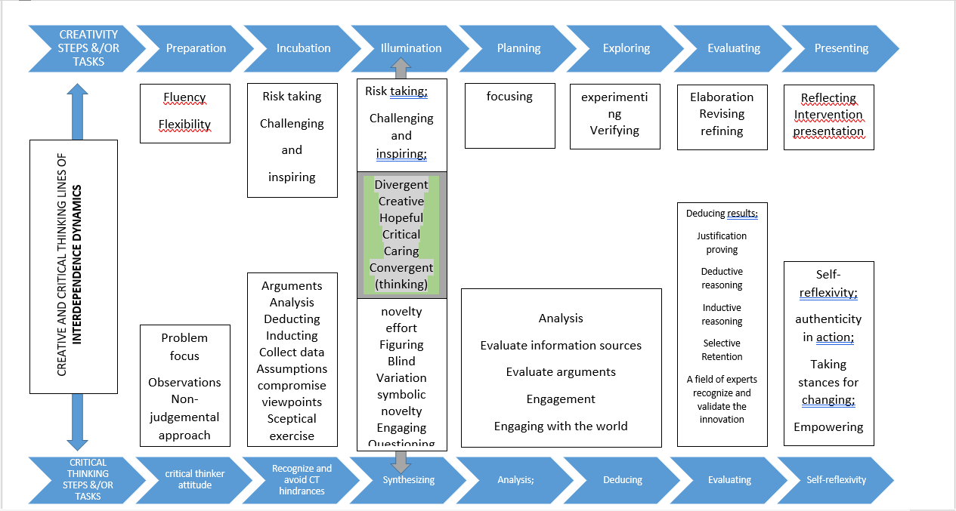

Slide 30
REFERENCES
Amabile, T. M. (1982). Social psychology of creativity: A consensual assessment technique. Journal of Personality and Social Psychology, 43, 997-1013. doi: 10.1037/0022-3514.43.5.997
Amabile, T.M., Conti, R., Coon, H., Lazenby, J., Herron, M. (1996). Assessing the work environment for creativity. The Academy of Management Journal, 39, 154-184.
Bacigalupo, M., Kampylis, P., Punie, Y., Van den Brande, G. (2016). EntreComp: The Entrepreneur- ship Competence Framework. Luxembourg: Publication Office of the European Union. doi:10.2791/593884
Barbot, B., Besançon, M., & Lubart, T. (2015). Creative potential in educational settings: Its nature, measure, and nurture. Education 3-13, 43(4), 371–381. https://doi.org/10.1080/03004279.2015.1020643
Biesta, G. (2015) What is education for? On good education, teacher judgment and education professionalism. European Journal of Education, 50(1): 75-87.
Brewer, A. (1992). Richard Cantillon: Pioneer of economic theory. London: Routledge.
Budi, G. S. and Farcis, F. (2021) Students’ Critical Thinking Skills in Innovating Problem Solving in the Physics Entrepreneurship Course. Berkala Ilmiah Pendidikan Fisika 9(1): 39-46. doi: 10.20527/bipf.v9i1.9517.
Christodoulou, D. (2014). Seven myths about education. New York: Routledge.
Colin, T. R. (2017) Analyzing ambiguity in the standard definition of creativity. AVANT. Pismo Awangardy Filozoficzno-Naukowej (S): 25-34.
Commission of the European Communities (2003). The Green Paper
on Entrepreneurship in Europe. Available online: http://eurlex.europa.eu/LexUriServ/site/en/com/2003/com2003 0027en01 .pdf
Critical Thinking Community (2022a) Our Concept and Definition of Critical Thinking, https://www.criticalthinking.org/pages/our-conception-of-critical-thinking/411, accessed 1 May 2022.
Critical Thinking Community (2022b) Defining Critical Thinking, https://www.criticalthinking.org/pages/defining-critical-thinking/766, accessed 1 May 2022.
Demir, M., Bacanlı, H., Tarhan, S. and Dombaycı, M. A. (2011) Quadruple Thinking: Critical Thinking. Procedia Social and Behavioral Sciences 12: 545–551.
Dornelas, J. C. A. (2008). Empreendedorismo - Transformando idéias em negócios. Rio de Janeiro: Elsevier.
Dunne, G. (2015) Beyond critical thinking to critical being: Criticality in higher education and life. International Journal of Educational Research 71: 86–99. doi: 10.1016/j.ijer.2015.03.003.
Han, B.-C- (2016). O aroma do tempo. Relógio d’Água.
Harari, Y. N. (2018). 21 lessons for the XXIst century. New York: Random House.Heslop, V. R. (2010). Sustainable capacity: Building institutional capacity for sustainable development. Auckland: University of Auckland.
Hasenkamp, W. and Namgyal, G. D. (2017) The plastic brain: Fundamentals of neuroscience and neuroplasticity. In: W. Hasenkamp and J. R. White (eds.) The monastery and the microscope: Conversations with the Dalai Lama on mind, mindfulness, and the nature of reality. Yale University Press, pp. 195-210.
Haynes, J. D. and Rees, G. (2006) Decoding mental states from brain activity in humans. Nature Review Neuroscience, 7: 523–534. doi: 10.1038/nrn1931.
Hidayati, N., Zubaidah, S., Suarsini, E. and Praherdhiono, H. (2019) Examining the Relationship between Creativity and Critical Thinking through Integrated Problem-based Learning and Digital Mind Maps. Universal Journal of Educational Research 7(9A): 171-179. doi: 10.13189/ujer.2019.071620.
Jung-Beeman, M., Bowden, E. M., Haberman, J., Frymiare, J. L., Arambel-Liu, S., Greenblatt, R., Reber, P. J. and Kounios, J. (2004) Neural activity when people solve verbal problems with insight. PLoS Biology 2: 500–510. doi: 10.1371/journal.pbio.0020097.
Kalar, B. (2020) The role of creativity in the context of academic entrepreneurship. Creativity and Innovation Management 29(2): 254-267. doi: 10.1111/caim.12352.
Kampylis, P. G. and Valtanen, J. (2010) Redefining creativity - analyzing definitions, collocations, and consequences. The Journal of Creative Behavior, 44(3): 191-214.
Kırbaşlar, M. and Özsoy-Güneş, Z. (2015) The Effect of Critical Thinking Disposition on Entrepreneurship Levels: A Study on Future Teachers. Procedia Social and Behavioral Sciences 174(1): 199–207. doi: 10.1016/j.sbspro.2015.01.647.
Knoff, J. and Timmons, S. (2015) From molecule to market: Implementation and assessment of a novel experiment promoting critical thinking and entrepreneurship in the organic chemistry laboratory. Abstracts of papers of the American Chemical Society, 250.
Lewis, C.A. (1996). Green Nature, Human Nature: The Meaning of Plants in Our Lives. Chicago: University of Illinois Press.
Ling, M. K. D. and Loh, S. C. (2019) Relationship of creativity and critical thinking to pattern recognition among Singapore private school students. The Journal of Educational Research 113(1): 59-76. doi: 10.1080/00220671.2020.1716203.
Martusewicz, R. & Johnson, L. (2016). Ecojustice education. In Van der Tuin (Ed.), Gender: Nature (pp. 57-71). MacMillan.
Martusewicz, R. A., Edmundson, J. & Lupinacci, J. (2011). EcoJustice Education: Toward diverse, democratic and sustainable communities. New York: Routledge
Mishra, P. and Henriksen, D. (2013) A NEW approach to defining and measuring creativity: Rethinking technology & creativity in the 21st century. TechTrends 57(5): 10.
Moore, T. (2013) Critical thinking: Seven definitions in search of a concept. Studies in Higher Education 38(4): 506–522. doi: 10.1080/03075079.2011.586995.
Niu, L., Behar-Horenstein, L. S. and Garvan, C. W. (2013) Do instructional interventions influence college students’ critical thinking skills? A meta-analysis. Educational Research Review 9: 114–128.
Oldham, G. R., & Cummings, A. (1996). Employee creativity: Personal and contextual factors at work. Academy of Management Journal, 39(3), 607–634. https://doi.org/10.2307/256657
Papageorgiou, G., Yiannaki, S. M. and Varnava-Marouchou, D. (2021) A Critical Evaluation of Contemporary Tools on Developing Innovative Thinking Competencies for Entrepreneurship. In: Proceedings of the European Conference on Innovation & Entrepreneurship, pp. 701–706. doi: 10.34190/EIE.21.270.
Papastephanou, M. and Angeli, C. (2007) Critical Thinking beyond skill. Educational Philosophy and Theory 39(6): 605-621. doi: 10.1111/j.1469-5812.2007.00311.
Paul, R. and Elder, L. (2001) Critical thinking: Tools for taking charge of your learning and your life. Upper Saddle River, NJ: Prentice Hall.

Slide 31
REFERENCES
Plucker, J. and Zabelina, D. (2009) Creativity and interdisciplinarity: One creativity or many creativities?. Zdm 41(1): 5-11.
Puig, B., Blanco-Anaya, P., Bargiela, I. M. and Crujeiras-Pérez, B. (2019) A systematic review on critical thinking intervention studies in higher education across professional fields. Studies in Higher Education 44(5): 860–869. doi: 10.1080/03075079.2019.1586333.
Reis, C. F. S. (Coord.) (2015). Entrepreneurship education. Insights on current challenges. Journal for Educators, Teachers and Trainers, Special Issue.
Rimanoczy, I. (2021) The sustainability mindset principles: A guide to developing a mindset for a better world. London /New York: Routledge.
Said-Metwaly, S., Kyndt, E., Van den Noortgate, W. (2017). Approaches to Measuring Creativity: A Systematic Literature Review. Creativity, Theories, Research,, Applications, 4(2): 238-275.
Sarwanto, Fajari, L. E. W. and Chumdari. (2021) Open-Ended Questions to Assess Critical-Thinking Skills in Indonesian Elementary School. International Journal of Instruction 14(1): 615-630. doi: 10.29333/iji.2021.14137a.
Schleicher, A. (2018) World class. How to build a 21st-century school system. Paris: OECD Publishing.
Sellars, M., Fakirmohammad, R., Linh Bui, L., Fishetti, J., Niyozov, S., Reynolds, R., Thapliyal, N., Liu-Smith Y-L and Ali, N. (2018) Conversations on Critical Thinking: Can Critical Thinking find Its way forward as the Skill Set and Mindset of the Century? Education Sciences 8: 205, doi: 10.3390/educsci8040205.
Suciu, T. (2014) The importance of Creativity in Education. Bulletin of the Transilvania University of Braşov 7(56- 2): 151-158.
Thompson, C. (2004) What are the Bounds of Critical Rationality in Education? Journal of Philosophy of Education 38(3): 485-492.
United Nations Educational, Scientific and Cultural Organization – UNESCO (2016). Assessment of transversal competencies. Policy and practice in the Asian-Pacific Region. Paris: UNESCO Bangkok Office.
Wechsler, S. M., Sainz, C, Rivas, S. F. Vendramini, C. M. M., Almeida, L. S. and Mundium, M. C. (2018) Creative and critical thinking: Independent or overlapping components? Thinking Skills and Creativity 27: 114-122.
White, r. & Stoecklin, v. (2011). Children's outdoor play & learning environments: Returning to nature. Obtido de http://www.whitehutchinson.com/children/articles/outdoor.shtml
Yaldiz, N. and Bailey, M. (2019) The effect of Critical Thinking on making the right decisions in the new venture process. Procedia Computer Science, 158: 281–286. doi: 10.1016/j.procs.2019.09.0533.

Slide 32


bem hajam
Fpce university of coimbra team

